Slide 1
Fun with Fossils!
We’re Diggin’ Up Bones!
Notes:
Advance Preparation:
Divide students into even groups with 3 or 4 members each.
Download and cut out sets of dinosaur bones (on last slide)
Set up sandboxes with pieces of dinosaur bones buried.
Set up boxes with equipment (brushes, shovels, goggles, paper, glue, crayons)
Materials Needed:
Boxes with sand, 1 per group
Plastic shovels
Paintbrushes
Paper fossils (on last slide), 1 set per group
Large sheets of white paper, 12x18, 1 per group
glue
Safety goggles, optional
Pencils
Crayons
Dinosaur books
Newspaper to put sandboxes on
Smartboard (you must have a smartboard to complete slide #6; if not available delete the hyperlink on the slide)

Slide 2
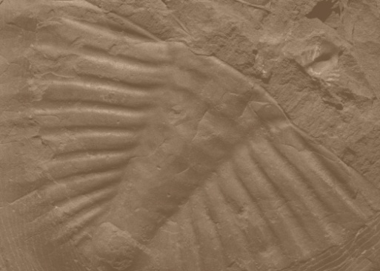
What are Fossils?
Fossils are what is left of living things from the past.
Fossils can be prints of animals or plants.
Some fossils are parts of things that were once living (like bones or teeth).
They can also be footprints, tracks, or nests.
Notes:
Ask students what they already know about fossils.
Say, “Let’s learn more about them”
Read aloud the presentation slides.

Slide 3
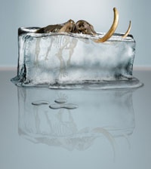
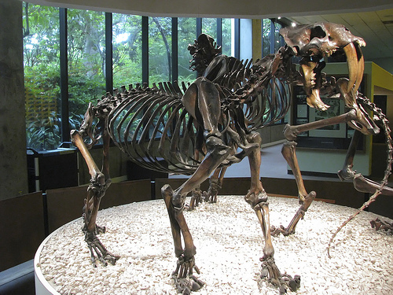
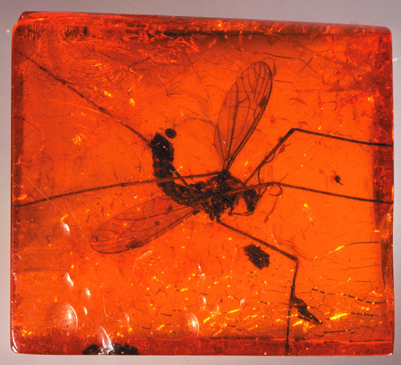
Where do you find fossils?
Many fossils are found in rock.
Some fossils have even been found in ice, tar, and amber. (hardened tree sap)

Slide 4
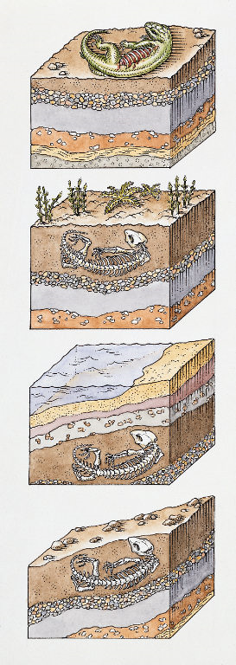
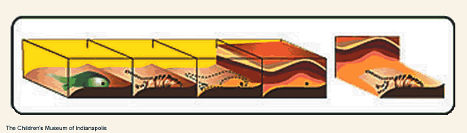
How are fossils formed?
Animals die and layers of mud, soil, or clay bury the remains over many, many years.
The layers build up leaving only the hard parts (bones and teeth) left over.
The mud, bones, and teeth slowly turn to hard rock over time.

Slide 5
Putting the Clues Together
Paleontologists – scientists who study things that lived long ago
They find and study fossils.
Sometimes Paleontologists work with skeletons. A skeleton is a full set of bones.
Skeletons help us to learn about animals, like how big it was and how it moved and what it ate.

Slide 6
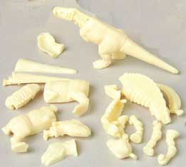
Puzzles
Sometimes fossils are like a jigsaw puzzle. The pieces have to be fitted together.
Dinosaur Bones
Notes:
Click on Dinosaur Bones to go to the puzzle website. Call on volunteers to put the skeletons together on the board.

Slide 7
Your Turn!
Today you get to be a paleontologist!
You and your group members get to dig up some bones!
Let’s find out what we have to do…
Notes:
Continue to read slides.

Slide 8
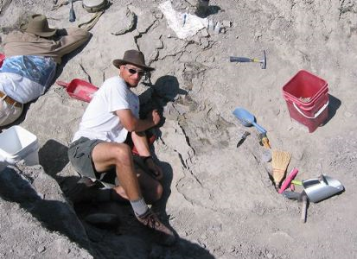
Finding a Dino
First, scientists uncover fossils from rock.
  They are VERY CAREFUL. Sometimes bones are teeny tiny and might get brushed away.
  Paleontologists use special tools such as shovels and picks.
  Sometimes they have to just use their hands.

Slide 9
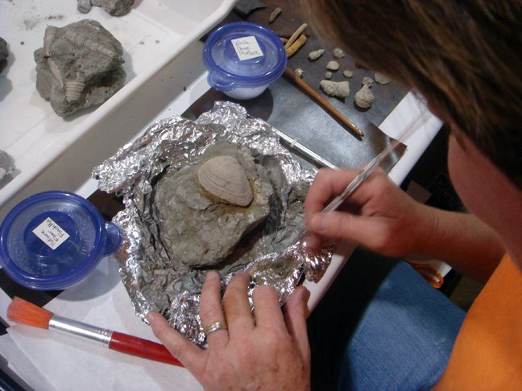
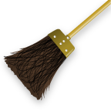
Finding a Dino
Second, Scientists clean the fossil pieces.
  They use special brushes to clean the dirt, mud, and other debris from the bones.

Slide 10
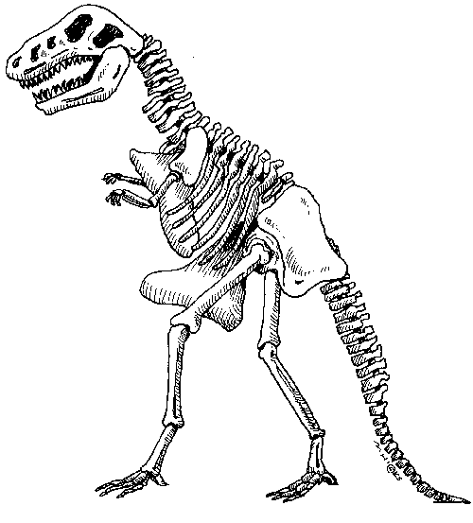
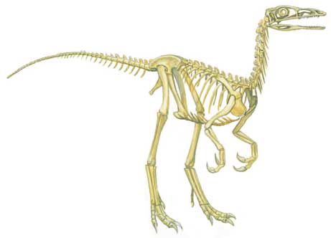
Finding a Dino
Next, Scientists put the fossil skeleton together.
  They have to carefully fit the pieces together.
  Special glue and wires help to hold the fossil together in order to form a full size model.

Slide 11
Group Activity
With your group members you will dig for bones.
Use all the special tools and equipment.
Don’t forget your safety goggles!
Remember to take turns when digging.
After you have found the bones, carefully fit them together into a dinosaur skeleton.
Glue the pieces on your white paper.
Answer these questions somewhere on your paper:
  What do you think this dinosaur is?
  What do you think it ate?
  Can you tell anything else about your dinosaur just by looking at the bones?
If you have time, draw a habitat for your dinosaur.
Notes:
Read aloud directions for Group Activity.
Pass out equipment to groups.
Give students 10 minutes to complete the activity. Allow 5 extra minutes if some groups are having difficulties.

Slide 12
Share your Dinosaur
What type of scientist were you today?
What tools did you use?
What kind of Dinosaur did you dig up?
What did it eat? How do you know?
Can you tell us anything else about your dinosaur just by looking at the bones?
Notes:
Allow groups to share their dinosaurs with the class. Ask these questions and have groups answer.

Slide 13
Dinosaur Cutouts for Activity
Notes:
You must have Adobe Acrobat to access the file. Double click on the above picture to access the entire file. Print out the first 3 pages for each of the 3 different dinosaurs. I use cardstock to print the designs on so they are a bit more durable. I’ve also printed them on different colored paper for different groups.

